Slide 1




Detection and Identification of Pills using Deep Learning
z

Slide 2
Abstract
Pill color, pill size and shape are few important characteristics for automatic pill detection. However, the environmental factors may cause an effect such that a change is produced in the above factors. Often medication errors occur that may cause complications to patients and all these are caused due to damage in labels and mismatches in medicine intake, etc. In this report, a trained system is proposed using Keras and TensorFlow mainly, for easy and quick identification of varieties of pills.
The detected pill (object detection) connects to the pill database wherein the pill name is detected. After the process of detection, the pre-trained dataset is used to identify the pill. Moreover, the dataset would also include the use cases and required detailed information of the respective pill. The project involves collecting datasets for automated medicine detecting technology. Effectiveness of the proposed method can be verified in the experimental results.

Slide 3
Existing System
Previous studies have commonly preprocessed pill images and then used image classification models to learn the surface area information of pills to perform classification tasks within a data set. Despite their diversity, several pills share limited information on appearance features (ie, shape, color, and form).
For example, many pills take the form of white circular tablets. This reduces the accuracy of pill identification and is a challenging factor in pill search models. Therefore, to increase the accuracy of pill identification, information on the characters imprinted on the pills can play a critical role. Researchers have also been aware of the importance of these characters and have attempted to solve this problem through image preprocessing.

Slide 4

Drawbacks
Less accuracy
There is no proper prediction

Slide 5
Proposed System
Our method considers the imprinted characters on pills as crucial information for pill identification. We adopted a character-level language model and convolutional networks for recognizing other features (ie, shape, color, and form). In addition, we divided the types of pills in the training and evaluation data sets to improve generalizability and thus the identification of new pills.
We overcame the limitations of the existing pill search models by designing a system that focuses on imprinted characters. First, the object detection model You Only Look Once (YOLO) version 5 was used to learn the locations and types of imprinted characters in a pill image. Next, the object recognition model was used to learn the shape, color, and form of the pill. In addition, we drew inspiration from the natural language processing field and considered the features of pills as context to learn the imprinted characters on pills in units of alphabet and number. In this study, the appearance of the pill (ie, shape, color, and form) is defined as features, and features and the imprinted characters are collectively referred to as characteristics.

Slide 6
Advantages
Better Prediction
High Accuracy

Slide 7
SOFTWARE REQUIREMENTS:
Operating System : Windows
Coding Language : Python

Slide 8
2
Hardware Components
Processor – Minimum Intel i3
Speed – 2.4 GHz
RAM – Minimum 4 GB
Hard Disk - Minimum 250 GB

Slide 9
Modules involved in the system
Upload image
in this module user can upload trained images using upload option we have took dataset from the kaggle website and upload to the proposed model
Generate Train & Test Model
We have to preprocess the gathered data and then we have to split the data into two parts training data with 80% and test data with 20% .
Analysis
In this module we will analyse the upload image using CNN algorithm
Predict
in this module finally we can predict the result based on input image

Slide 10
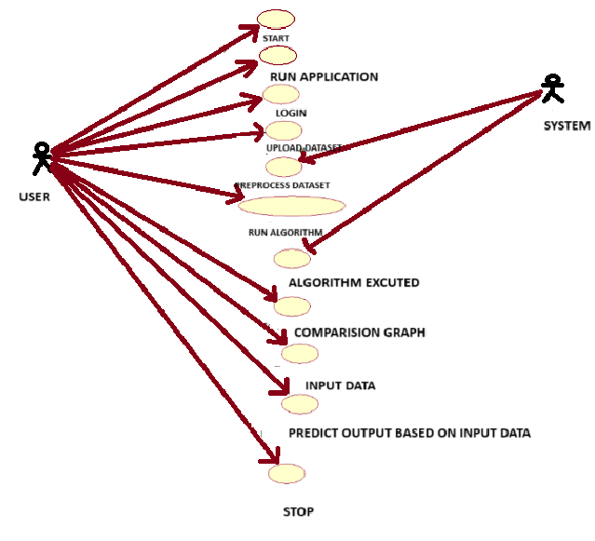
UML

Slide 11
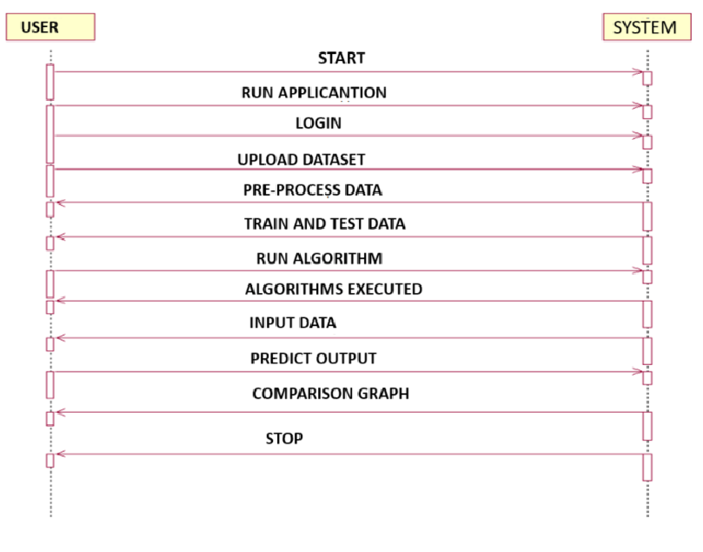
SEQUENCE DIAGRAM

Slide 12
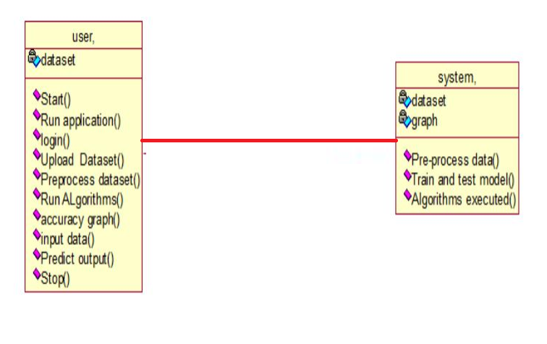
CLASS DIAGRAM

Slide 13
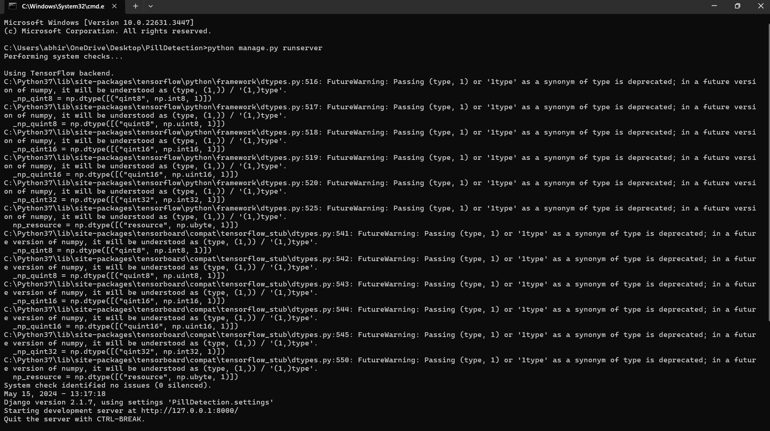
IMPLEMENTATION

Slide 14


Slide 15
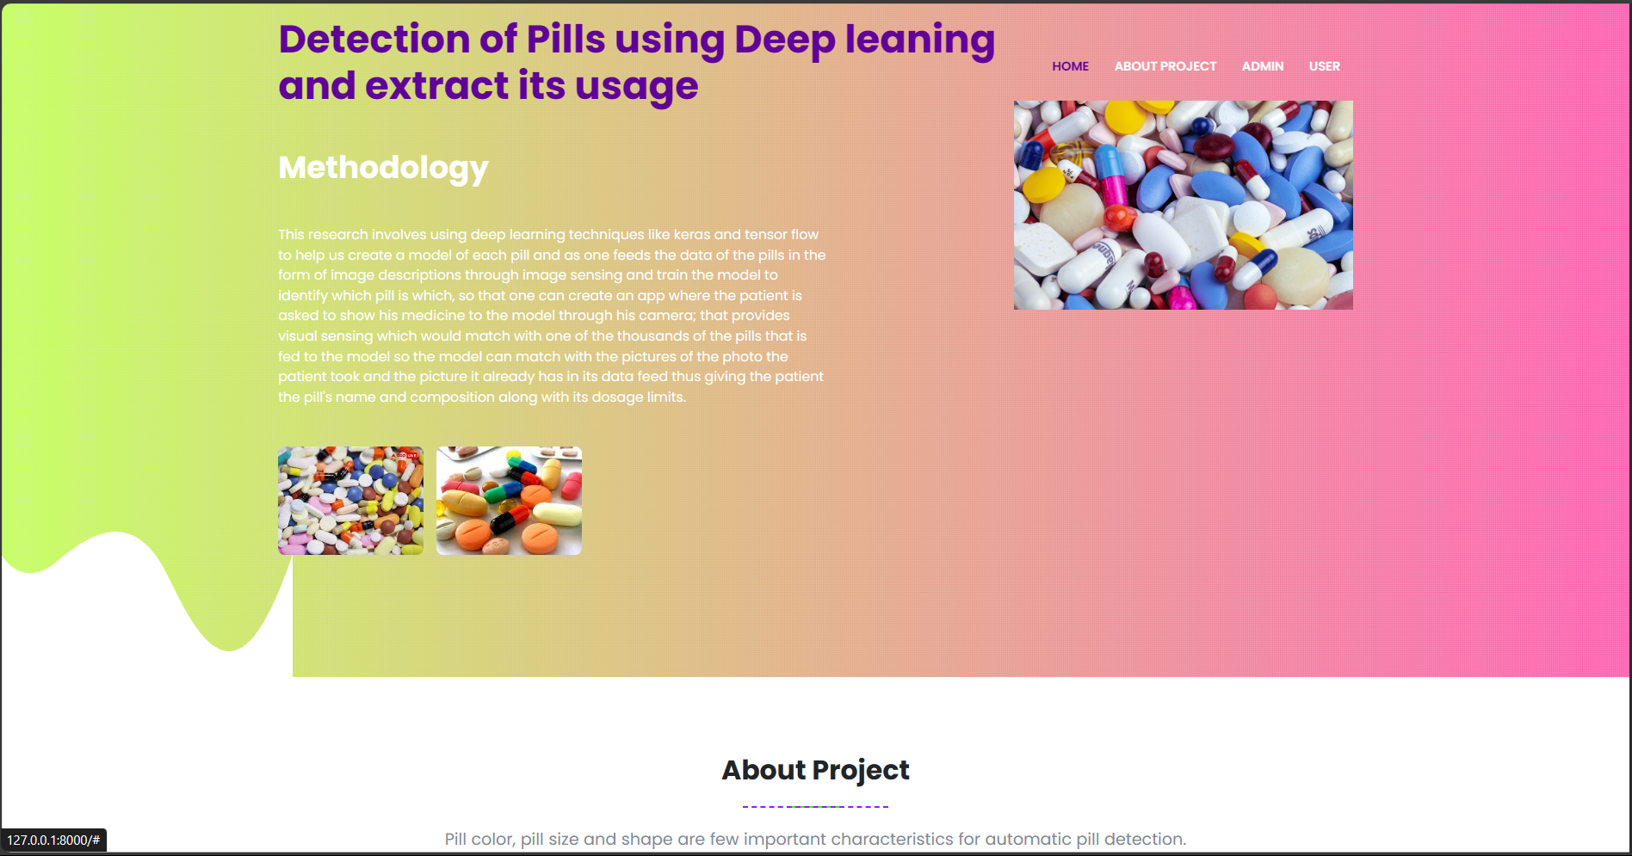

Slide 16
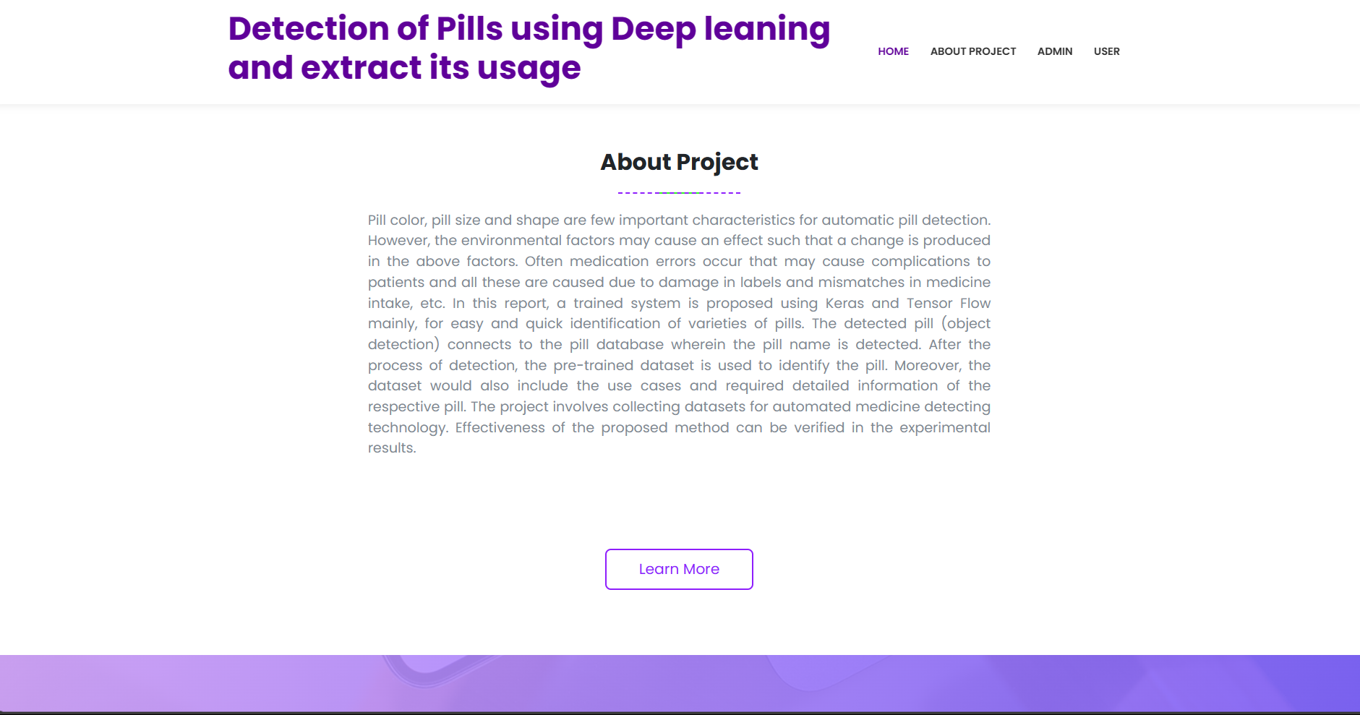

Slide 17
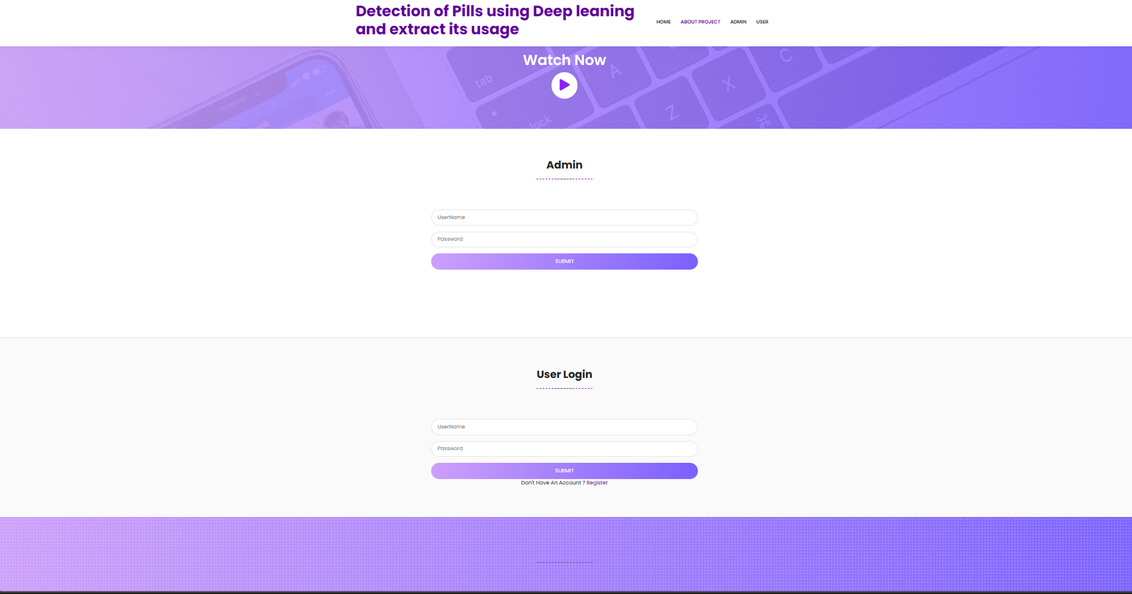

Slide 18
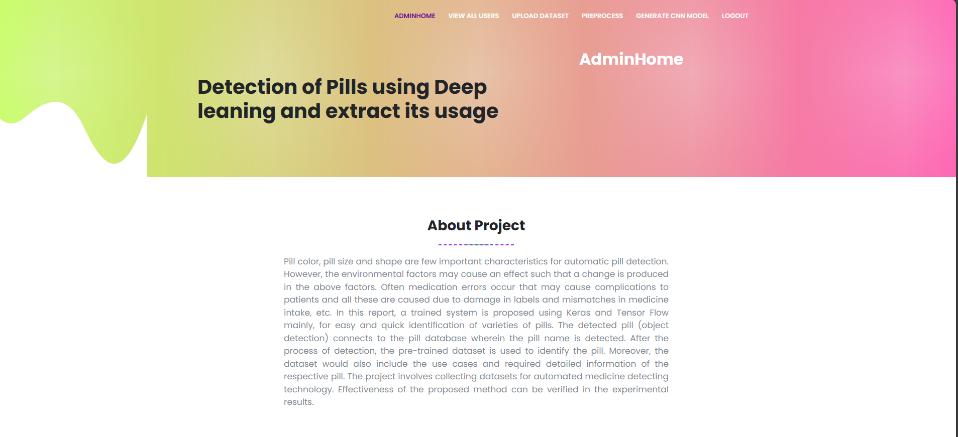
ADMIN PAGE

Slide 19
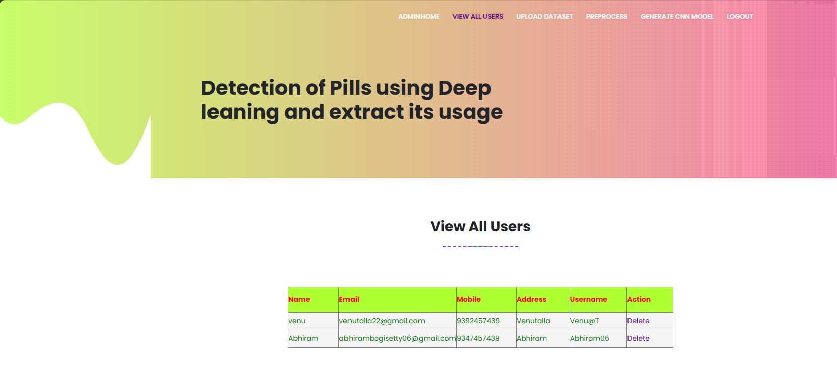

Slide 20
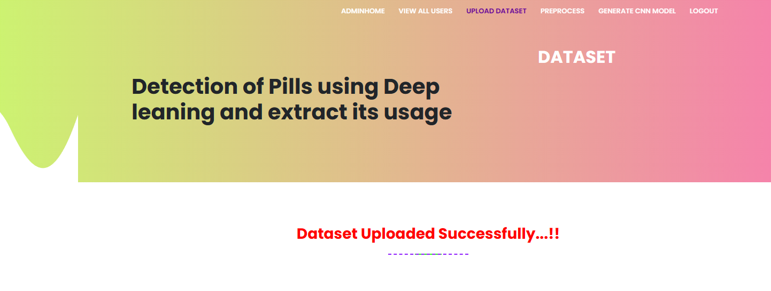

Slide 21
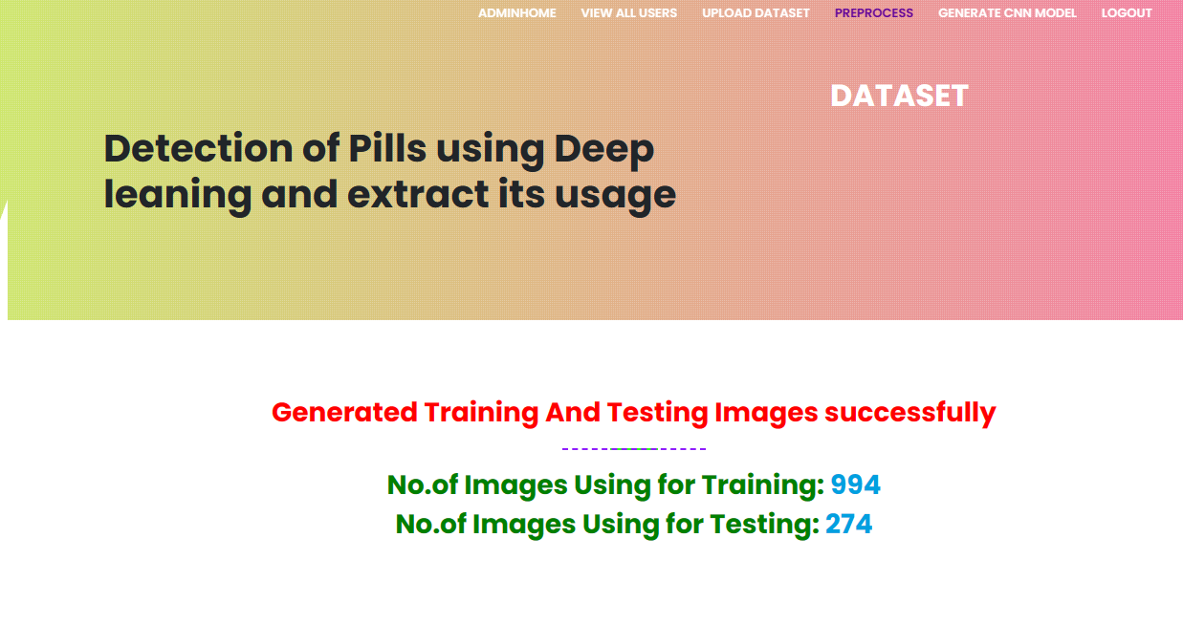

Slide 22
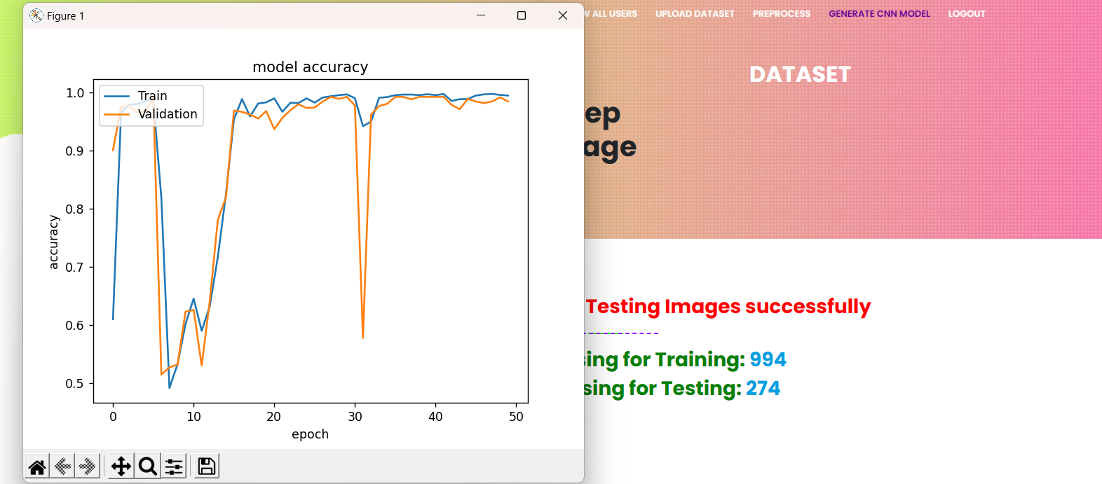
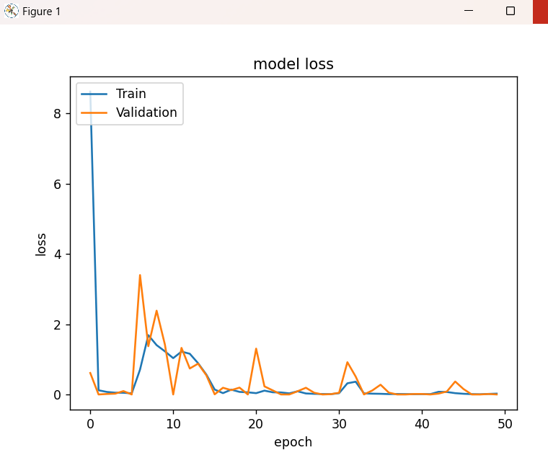

Slide 23
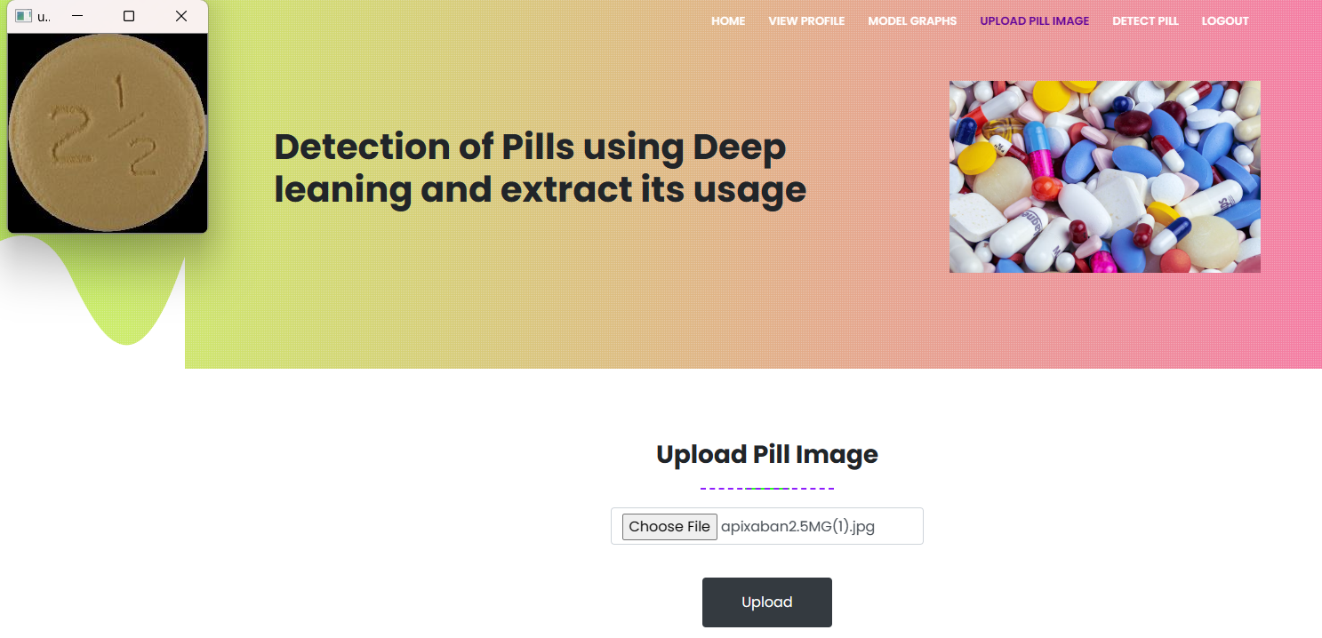
USER PAGE

Slide 24
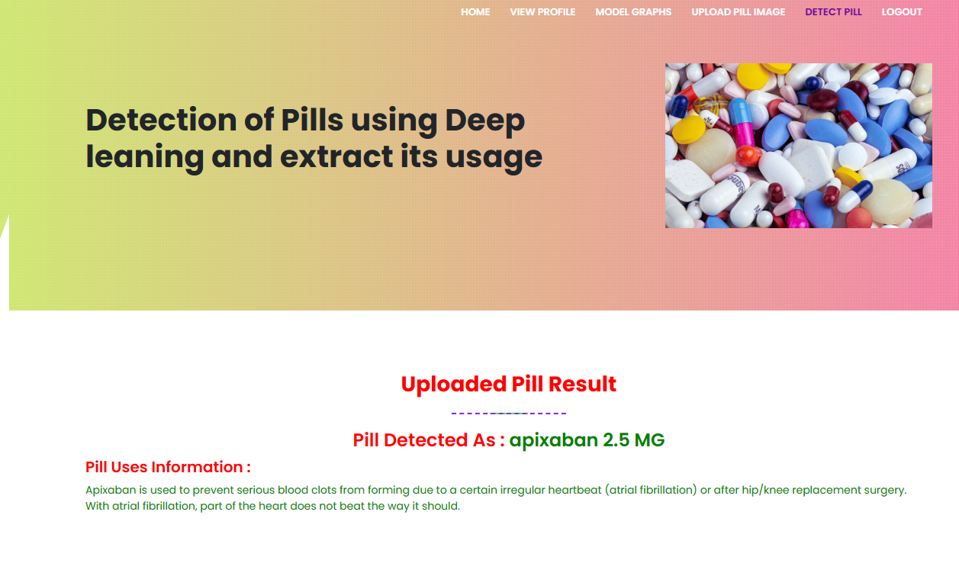

Slide 25
CONCLUSION
In conclusion, the literature survey provides a comprehensive overview of the application of deep learning techniques in the detection of pills, showcasing a paradigm shift in pharmaceutical image analysis. The reviewed studies collectively demonstrate the potential of deep learning models in automating the identification and classification of pills, offering a range of benefits to the healthcare industry.
The evolution from traditional image processing methods to sophisticated deep learning architectures highlights the capacity of neural networks to learn intricate features from pill images. Convolutional Neural Networks (CNNs) and other deep learning models have shown remarkable success in accurately detecting pills based on visual characteristics such as shape, color, and imprints.

